Slide 1
Market Segmentation In Insurance
WISDOM IZUCHUKWU ADIKE

Slide 2
Contents
Dataset Description
Main objectives of the analysis.
EDA, Data Cleaning, Feature Engineering
Applying Clustering Algorithms.
Machine learning analysis and findings.
Models flaws and advanced steps.

Slide 3
Dataset Description

Slide 4
Introduction
In marketing, market segmentation is the process of dividing a broad consumer or business market, normally consisting of existing and potential customers, into subgroups of consumers based on some type of shared characteristics. This case requires developing a customer segmentation to give recommendations like saving plans, loans, wealth management, etc. on target customer groups. The sample Dataset summarizes the usage behavior of about 9000 active credit cardholders during the last 6 months. The file is at a customer level with 18 behavioral variables.

Slide 5
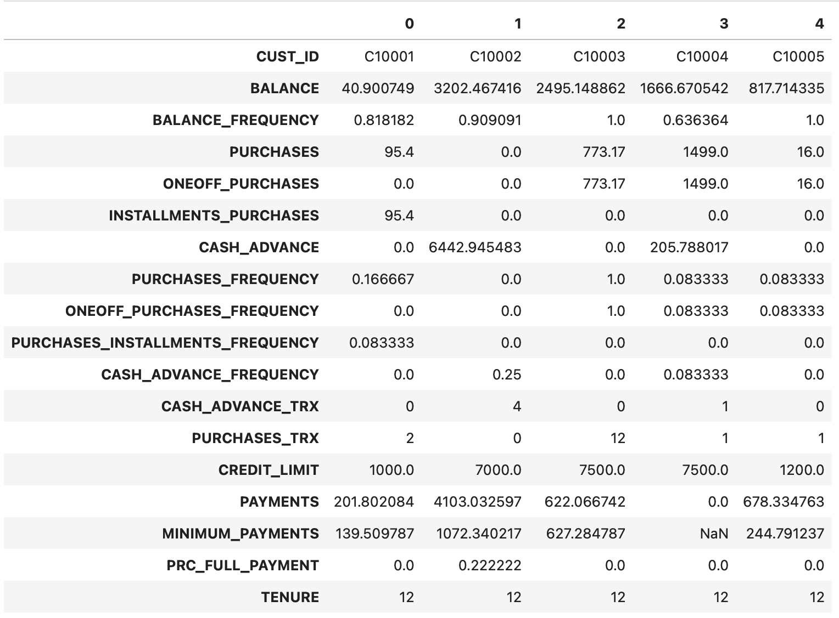
Dataset Description 01
About the features
We have 18 variables in Market Segmentation dataset with more focus on the 'TENURE' columns.
(rows, columns) | (8950, 18)

Slide 6
Dataset Description 02
CUST_ID: Customer ID or identifier.
BALANCE: Current account balance.
BALANCE_FREQUENCY: Frequency of maintaining a balance.
PURCHASES: Total purchases made.
ONEOFF_PURCHASES: Purchases made as one-time transactions.
INSTALLMENTS_PURCHASES: Purchases made in installments.
CASH_ADVANCE: Total cash advances taken.
PURCHASES_FREQUENCY: Frequency of purchase transactions.
ONEOFF_PURCHASES_FREQUENCY: Frequency of one-off purchase transactions.
PURCHASES_INSTALLMENTS_FREQUENCY: Frequency of installment purchase transactions.
CASH_ADVANCE_FREQUENCY: Frequency of cash advances.
CASH_ADVANCE_TRX: Number of cash advance transactions.
PURCHASES_TRX: Number of purchase transactions.
CREDIT_LIMIT: Credit limit on the account.
PAYMENTS: Total payments made.
MINIMUM_PAYMENTS: Minimum required payments.
PRC_FULL_PAYMENT: Percentage of full payments.
TENURE: Account tenure in months.

Slide 7
Main Objective of the analysis:
In this section, we will conduct a thorough examination of the dataset using various Exploratory Data Analysis (EDA) methods. These methods will involve investigating null values, assessing data skewness, and employing data visualization. Additionally, we will illustrate the relationships between the dataset's features to facilitate feature engineering and data cleaning processes.

Slide 8
Exploratory Data Analysis (EDA) and
Feature Engineering

Slide 9
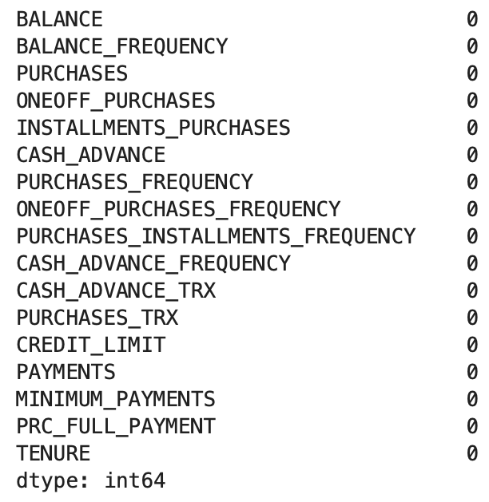
Exploratory Data Analysis 01
First of all, we dropped the CUST_ID column since it will be irrelevant for our machine learning algorithm.
Then, we treated the missing values by replacing the NaN with the mean value of the numerical columns and the modal value of the categorical columns with where MINIMUM_PAYMENTS and CREDIT_LIMIT columns contains 313 and 1 missing values respectively.

Slide 10
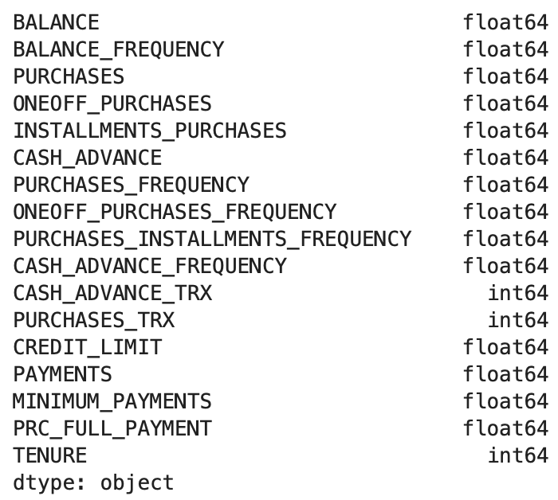
Exploratory Data Analysis 02
Identifying numerical variables that are categorical by their data types which is int64.
While float64 are numerical variables that will be suitable for scaling.

Slide 11
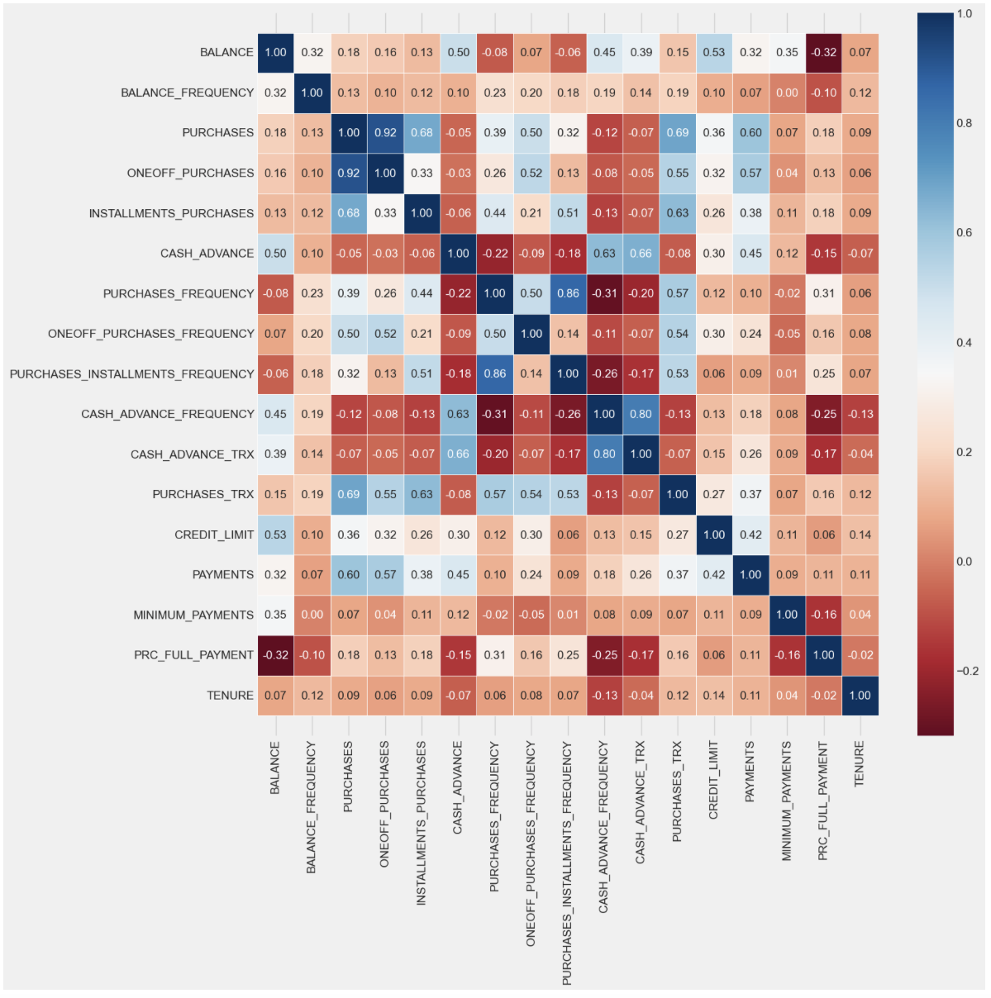
Exploratory Data Analysis 03
The objective of this matrix is to display the associations among features, which proves beneficial for upcoming feature engineering techniques. In the following slides, we will provide a more detailed presentation of these correlations using data frames for better clarity.

Slide 12
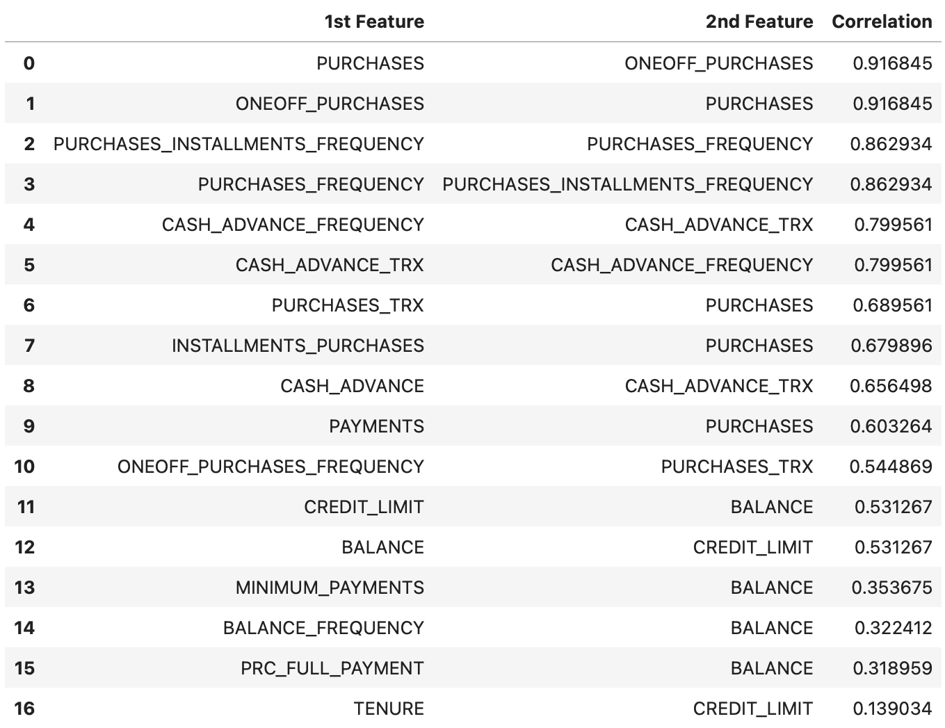
Exploratory Data Analysis 03
It's evident that there exists a strong correlation among the features, primarily because a significant portion of them pertains to geometric characteristics that describe the shape of the dataset.

Slide 13
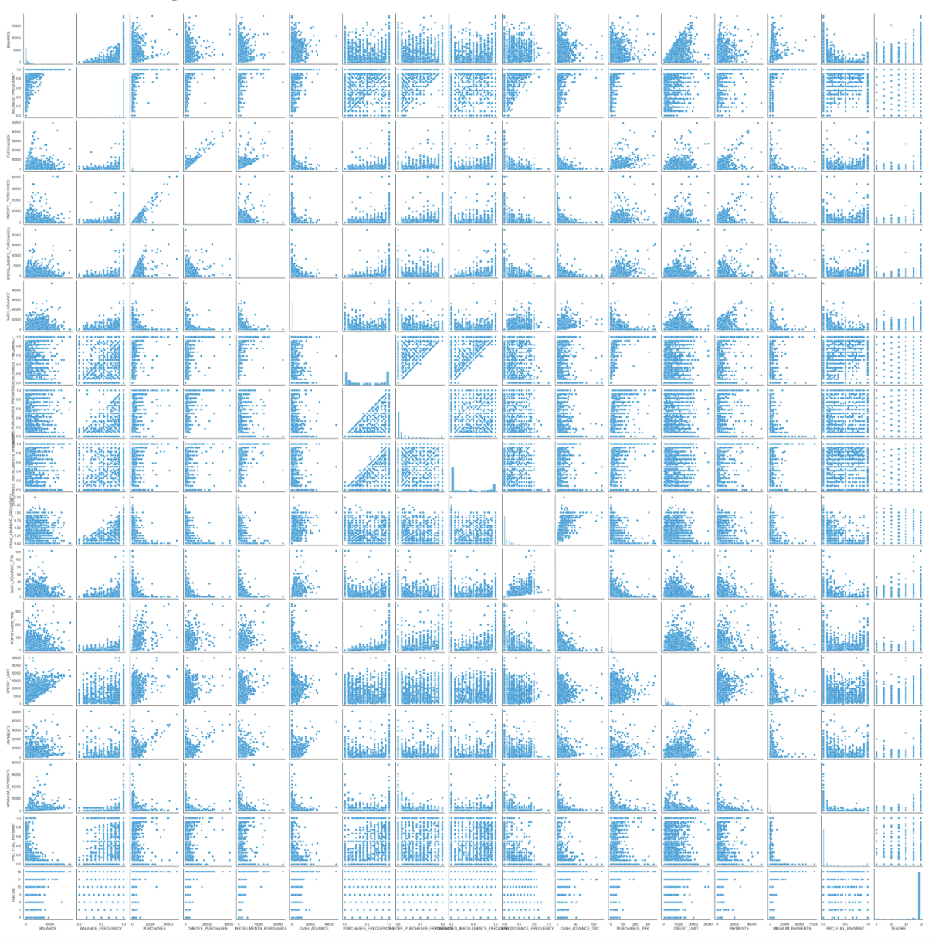
Exploratory Data Analysis 04
By utilizing a pair plot, we can examine the linearity between the features and also gain insight into how the dataset are distributed, forming distinct clusters.

Slide 14
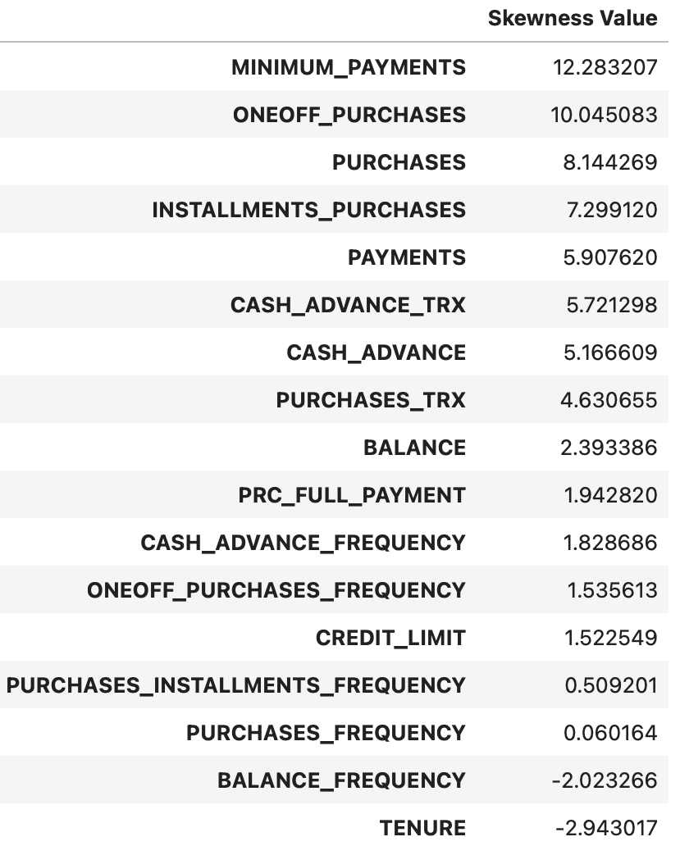
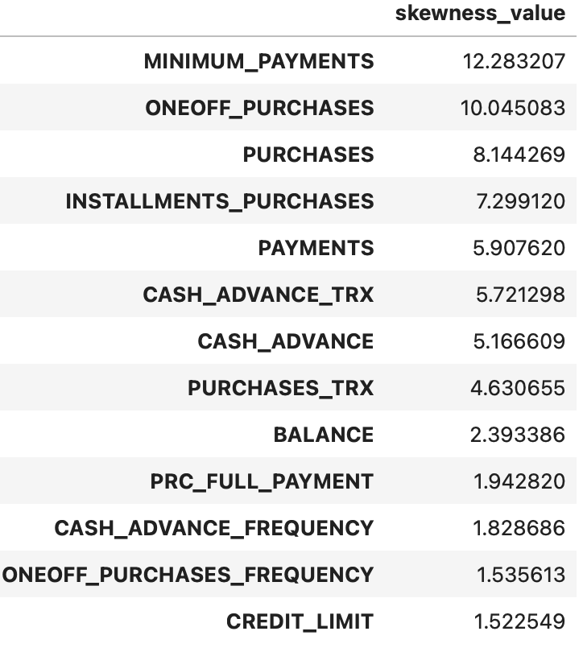
Exploratory Data Analysis 05
Assessing skewness in the features as a step for transformations.
We consider the following aspects:
(nearly 0) or (-0.75 < value < 0.75): No skewness
Positive (value > +0.75): Right skewness
negative (value < -0.75): left skewness

Slide 15
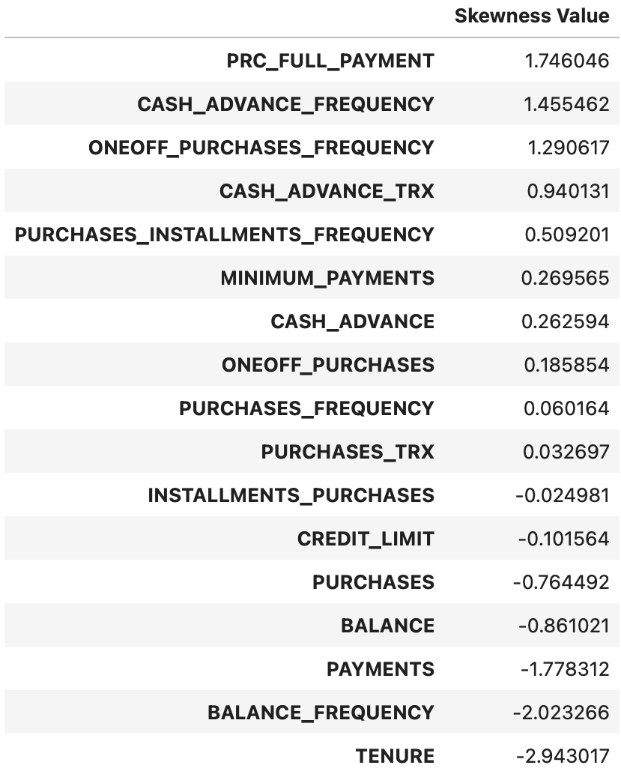
Featuring Engineering 01
Applying Log transformation to right skewed data.
Note that when we apply log transformation to the features, it effectively addresses only positive skewness. This transformation aims to convert right skewness into left skewness, ultimately achieving a symmetric or normal distribution.

Slide 16
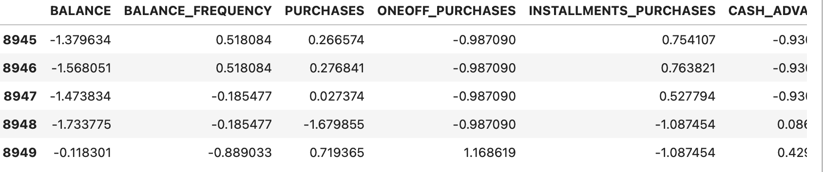
Featuring Engineering 02
Applying feature scaling for Machine Learning
Feature scaling is particularly important in machine learning models that rely on distance metrics. When employing clustering methods such as K-means, which heavily relies on distance metrics, it's crucial to scale our features appropriately to ensure accurate clustering results.

Slide 17
Machine Learning Analysis and Findings

Slide 18
Machine Learning Analysis and Findings:
In the upcoming slides, we will conduct a comparison among four distinct clustering methods: K-means, Agglomerative Hierarchical clustering, DBSCAN, and MeanShift. Our evaluation will focus on determining the optimal number of clusters and comparing the clustered observations with the expected target variable across the entire dataset.

Slide 19
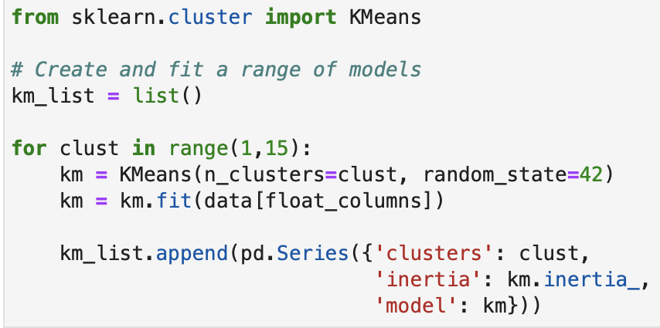
Machine Learning Analysis 01
Performing K-Means
In this section, we have applied the K-means algorithm to the dry bean dataset, testing a range of different K values from 0 to 20. The aim is to determine the most suitable number of clusters. To assess the model's quality, we've employed the inertia metric and the elbow method. Inertia is defined as the sum of squared distances from each data point (Xi) to its assigned cluster (Ck).

Slide 20
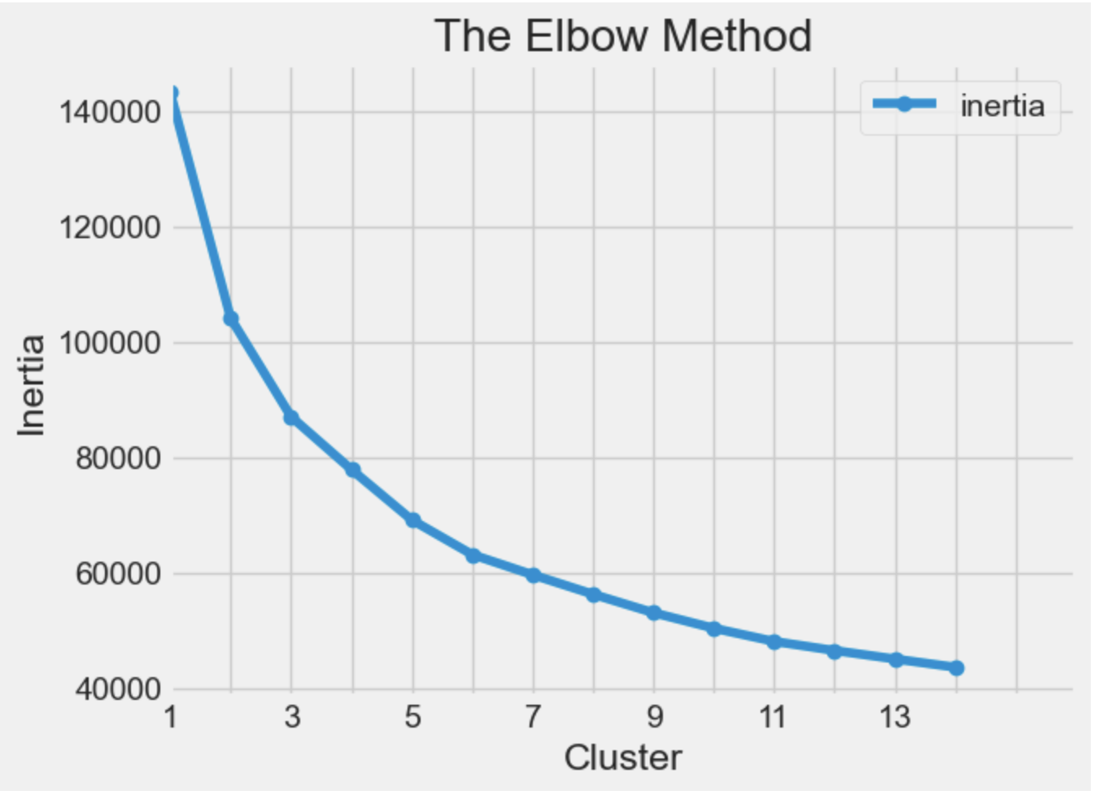
Machine Learning Analysis 02
Elbow Method
As depicted in the graph, when following the elbow method approach, it becomes evident that the suitable number of clusters falls within the range of 3 to 5. This observation aligns with our dataset, which inherently comprises four distinct clusters.

Slide 21
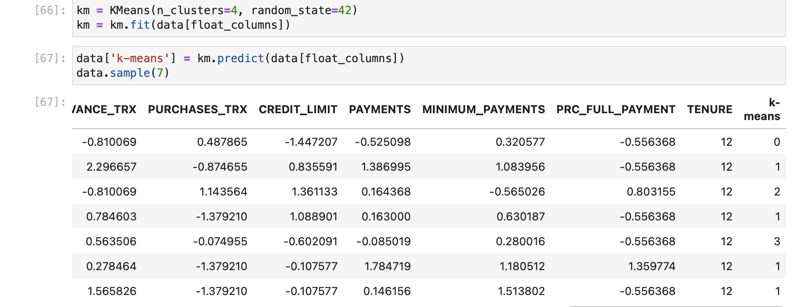
Machine Learning Analysis 03
Applying K = 4
Upon applying the K-means algorithm with the number of clusters set to 4 on the dataset, the algorithm will categorize each observation into one of the four clusters as defined in the model. Subsequently, we can assess how many of these observations have been correctly classified into their respective clusters.

Slide 22
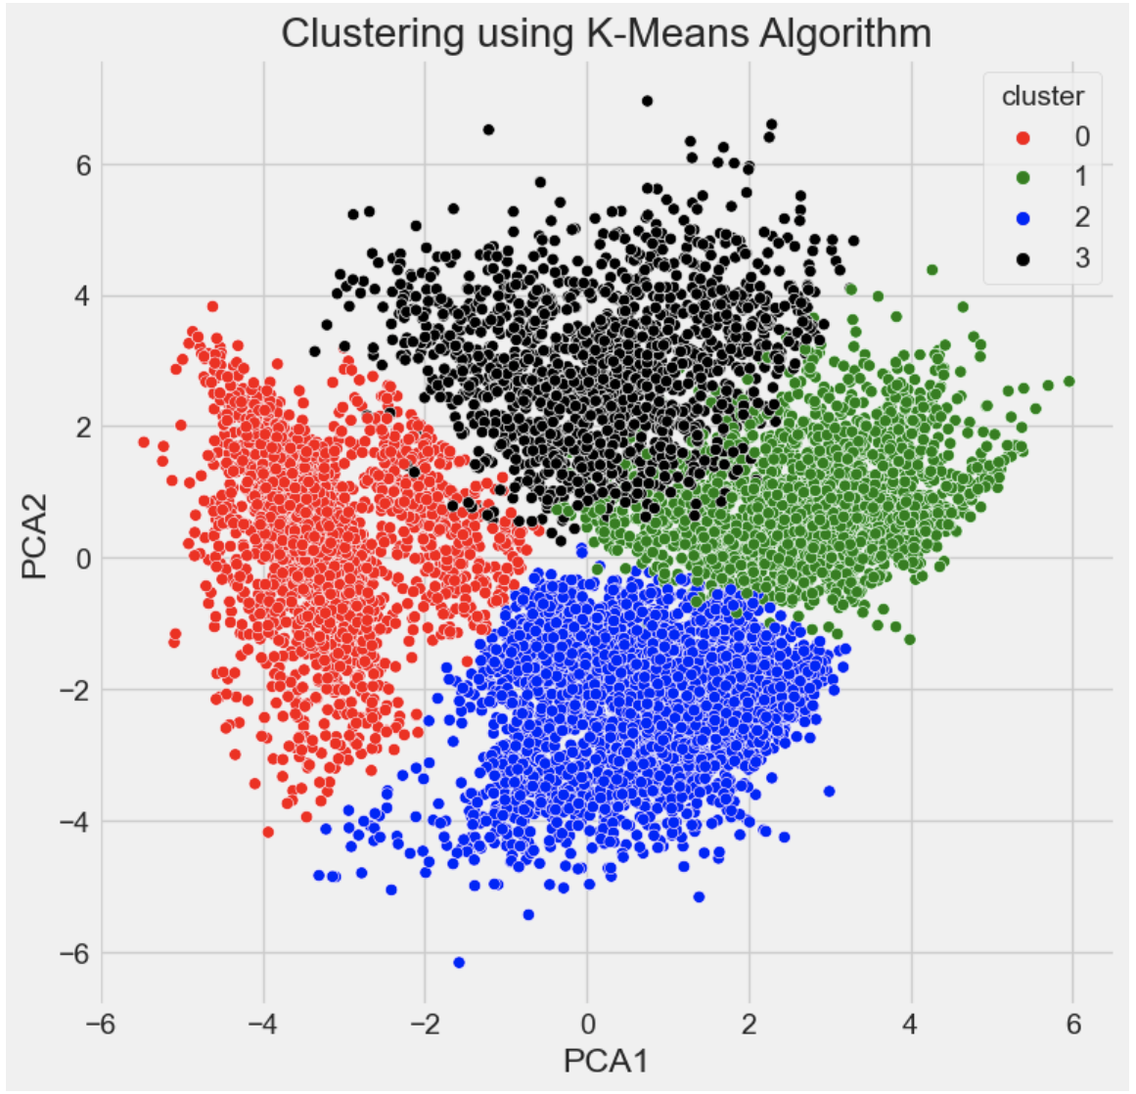
Machine Learning Analysis 04
Grouping clusters
After performing PCA to 2 dimensions, we applied k = 4 and grouped the clusters in order to validate our clustering model with the actual classes labeling.

Slide 23
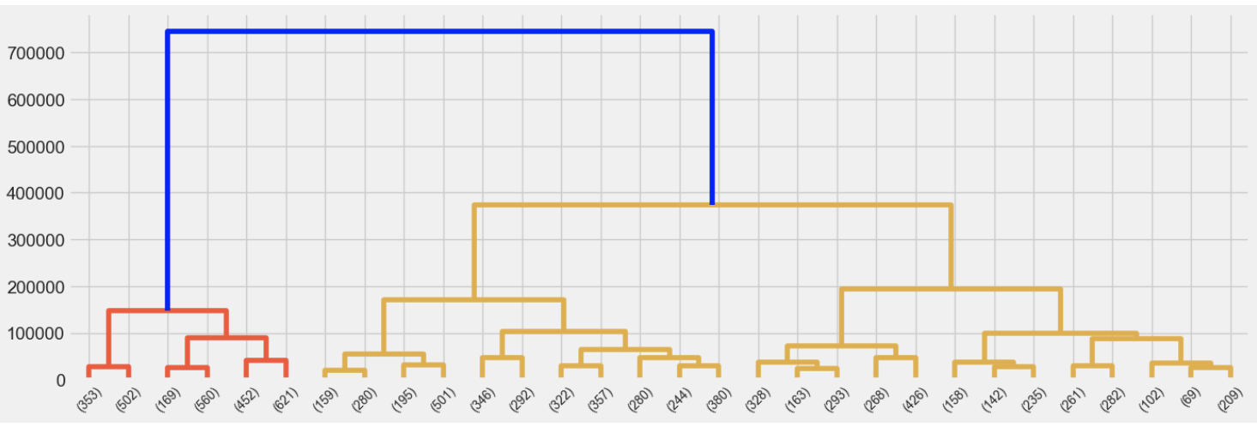
Machine Learning Analysis 05
Agglomerative Clustering
Applying agglomerative hierarchical clustering with number of clusters = 4

Slide 24
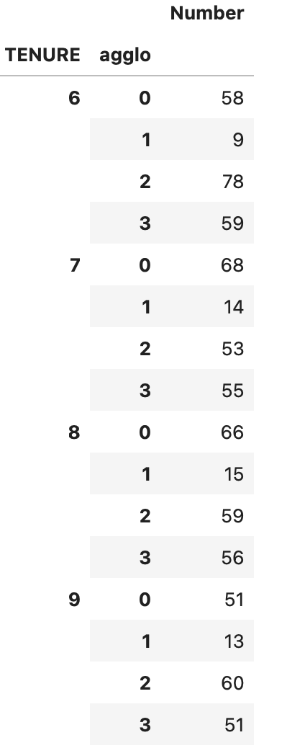
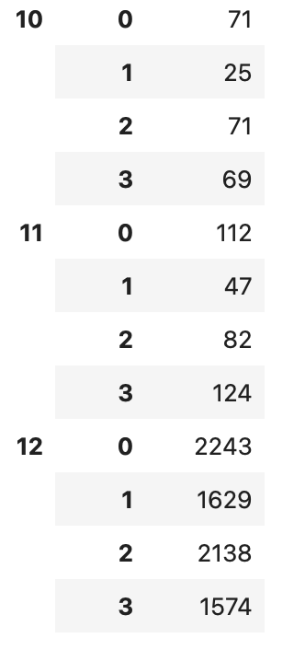
Machine Learning Analysis 06
Grouping the agglomerative clusters
We grouped the clusters in order to validate our clustering model with the actual classes labeling from TENURE.

Slide 25
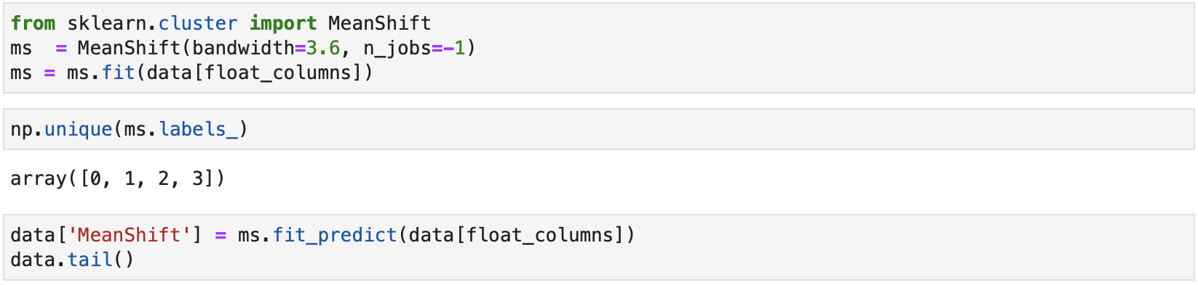
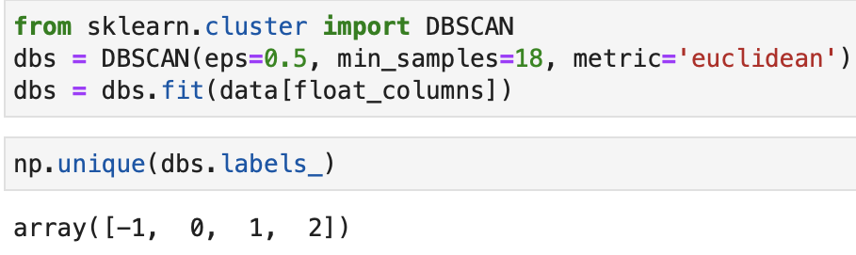
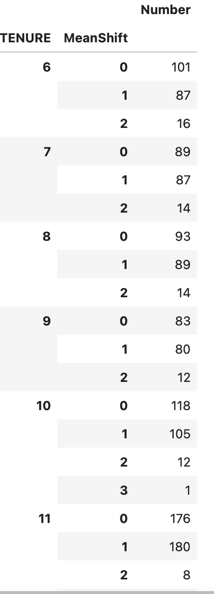
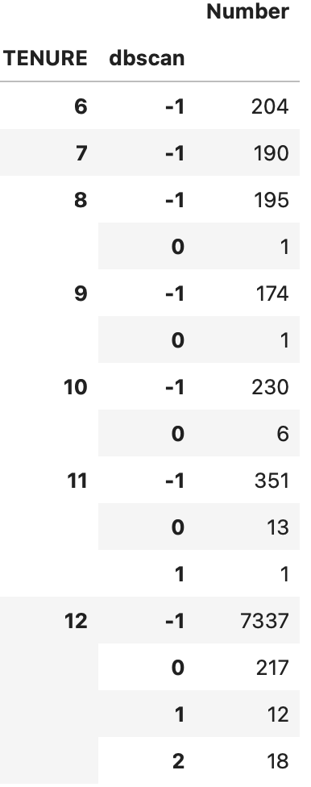
Machine Learning Analysis 07
DBSCAN and MeanShift Clustering
After conducting multiple iterations of these two algorithms with various parameter settings, we encountered unsatisfactory results. Despite the algorithms correctly predicting the optimal number of clusters, our validation process revealed a high error rate when comparing the clustered observations to the classes.

Slide 26
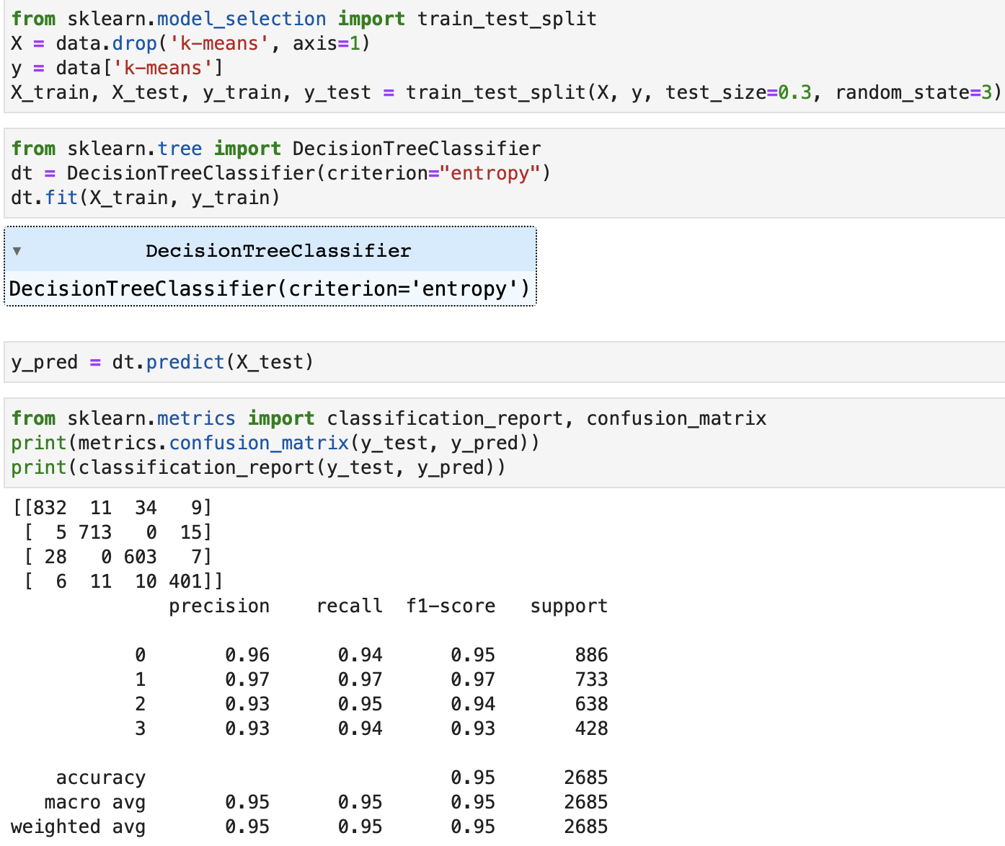
Machine Learning Findings
Model comparisons
If you'd notice from the picture, we used Decision Tree to fit our K-Means in the entire dataset and check for accuracy which is 95%. As mentioned in the previous slide, DBSCAN and MeanShift algorithms yielded unsatisfactory results when it came to clustering observations. Therefore, we will exclude them from the comparison, focusing solely on assessing the performance of the K-means and Agglomerative Clustering algorithms. K-MEANS is the best clustering algorithm for this dataset.

Slide 27
Model Flaws and Strength and Findings

Slide 28
Machine flaws and Strength:
Both the K-means and Agglomerative Hierarchical Clustering methods demonstrated efficiency and accuracy in determining the suitable number of clusters. Additionally, they successfully clustered the majority of observations with an accuracy rate exceeding 90%.
In contrast, DBSCAN and MeanShift algorithms demanded significant time and effort to identify the appropriate number of clusters. This process involved repeatedly adjusting parameters to achieve the desired cluster count. Furthermore, these algorithms produced subpar results in terms of accurately clustering the observations.

Slide 29
Advanced Steps:
To improve the clustering process with DBSCAN and MeanShift, we have a couple of options. One approach is to use image data from the scanned images, as both algorithms are well-suited for computer vision applications. Alternatively, we can employ grid search and hyperparameter tuning to find the best parameters for these algorithms. However, it's important to note that tuning parameters, especially for the MeanShift model, can be time-consuming.

Slide 30
Thank you
WISDOM IZUCHUKWU ADIKE

